Slide 1

Customer Behaviour Analysis
Analyzing 3,900 customer transactions to uncover spending patterns, preferences, and strategic opportunities for business growth.

Slide 2
Dataset Overview
3,900
18
50
25
Total Purchases
Data Points
Locations
Products
Transactions analyzed across all categories
Features covering demographics and behavior
Geographic distribution of customers
Unique items purchased
Key features include customer demographics, purchase details, shopping behavior, and subscription status. Only 37 missing values in Review Rating column.

Slide 3
Data Preparation Process
01
02
Data Loading & Exploration
Cleaning & Standardization
Imported dataset using pandas, analyzed structure with df.info() and summary statistics
Imputed missing Review Ratings using median by category, renamed columns to snake_case
03
04
Feature Engineering
Database Integration
Created age_group and purchasing_period columns, verified data consistency
Connected to PostgreSQL and loaded cleaned data for SQL analysis

Slide 4
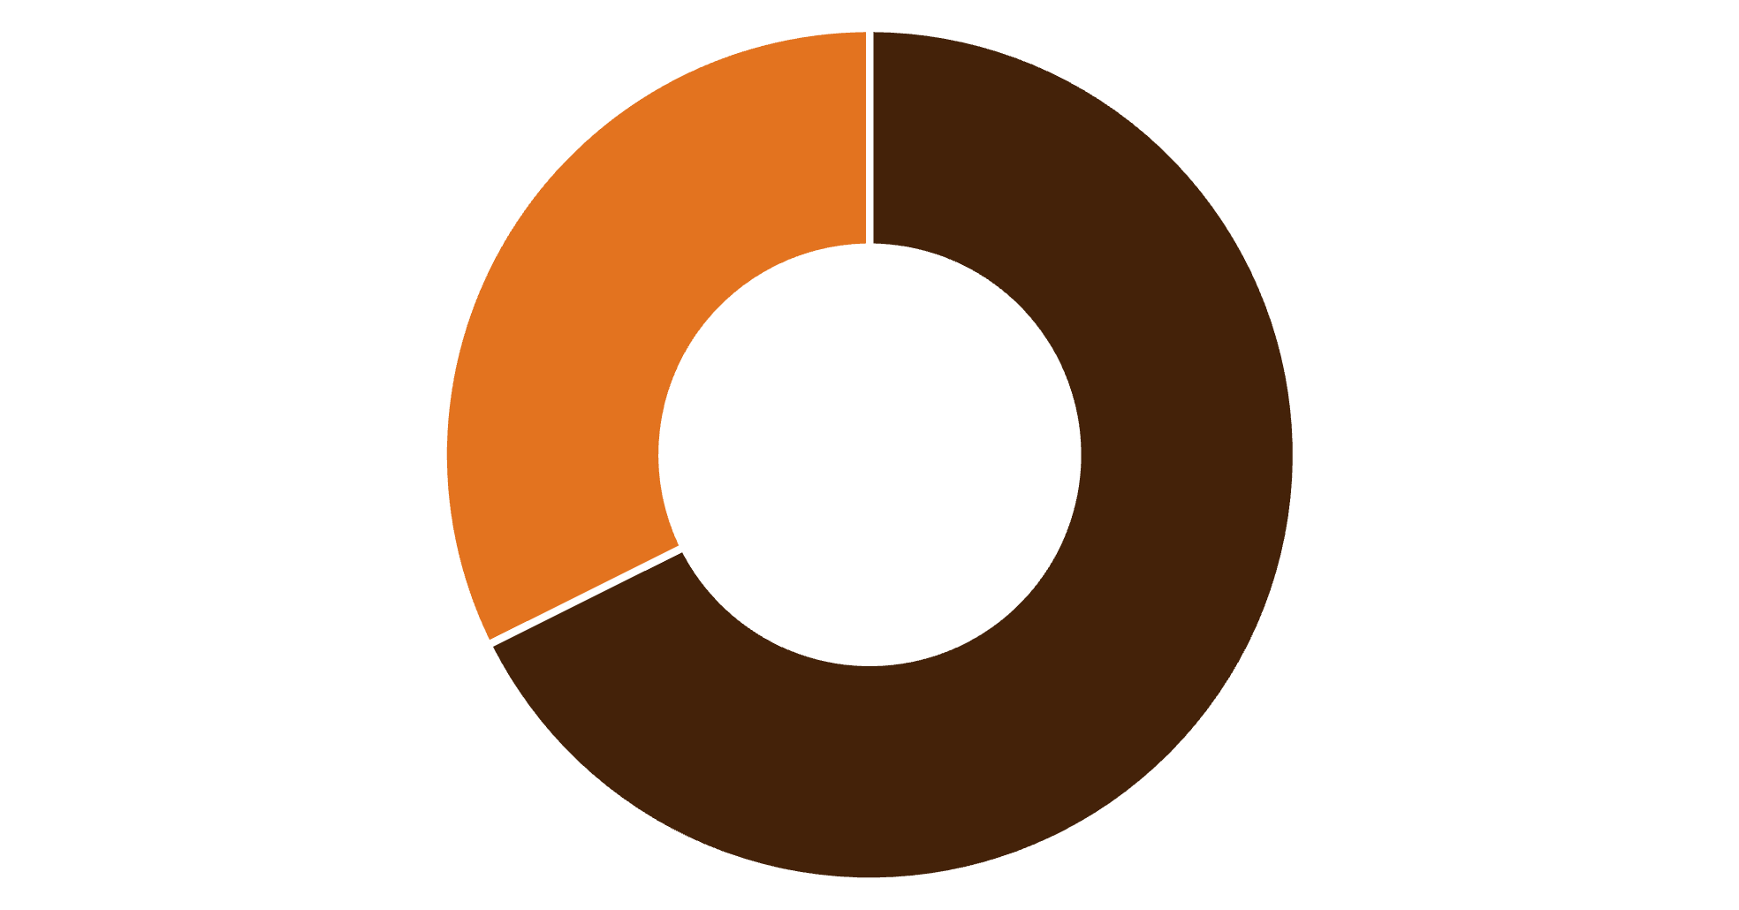
Revenue by Gender
Male Customers Drive Revenue
Male customers generated $157,890 in total revenue, more than double the $75,191 from female customers.
This significant gap suggests opportunities for targeted marketing to female segments.
Male
Female

Slide 5
Customer Insights
High-Value Discount Users
Express Shipping Premium
Top-Rated Products
839 customers used discounts but still spent above average purchase amount
Express shipping users spend $60.48 on average vs. $58.46 for standard
Gloves (3.86), Sandals (3.84), and Boots (3.82) lead in customer satisfaction

Slide 6



Customer Segmentation
New
1
83
Returning
2
701
Loyal
3
3,116
The majority of customers (80%) fall into the Loyal segment, demonstrating strong retention. However, only 2% are new customers, indicating a need for acquisition strategies.

Slide 7

Subscription Analysis
Subscribers vs. Non-Subscribers
1,053 subscribers generated $62,645 in revenue
2,847 non-subscribers generated $170,436
Average spend nearly identical: $59.49 vs. $59.87
958 repeat buyers (>5 purchases) have subscriptions

Slide 8




Top Products by Category
Accessories
Clothing
Jewelry (171), Belt (161), Sunglasses (161)
Blouse (171), Pants (171), Shirt (169)
Footwear
Outerwear
Sandals (160), Shoes (150), Sneakers (145)
Jacket (163), Coat (161)
Discount-dependent products: Hat (50%), Sneakers (49%), Coat (49%), Sweater (48%), Pants (47%)

Slide 9
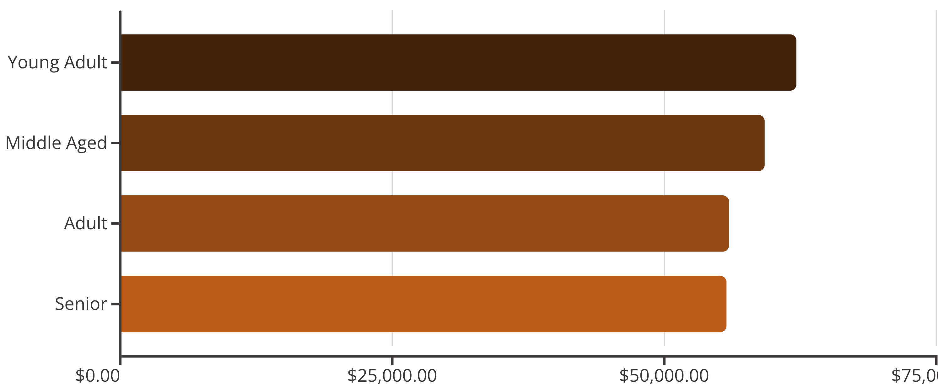
Revenue by Age Group
Young Adults lead revenue generation at $62,143, with relatively balanced contributions across all age groups.

Slide 10





Strategic Recommendations
Boost Subscriptions
Promote exclusive benefits to convert non-subscribers and increase lifetime value
Customer Loyalty Programs
Reward repeat buyers to strengthen the Loyal segment and increase retention
Optimize Discount Strategy
Balance promotional sales with margin control, especially for discount-dependent products
Targeted Marketing
Focus on high-revenue age groups, express shipping users, and top-rated products

